Slide 1
Intelligent and Weather Adaptive Street Lighting System
TEAM AE-16
TEAM MEMBERS
NAME ROLL
AKASH ARYAN 523
SHOURYA 553
NITIN KUMAR 538
SHUBHAM KUMAR 518
VAIBHAV KUMAR 513

Slide 2
INTRODUCTION
The street lighting is one of the largest energy expenses for a city. An intelligent street lighting system can cut municipal street lighting costs by 50%-70%.
An intelligent street lighting system is a system that adjusts light output based on usage and occupancy.
An intelligent street light management proposes the installation of the wireless based system to control the actual energy consumption of the street lights and take appropriate energy consumption reduction measures through power conditioning and control.

Slide 3
PROBLEM STATEMENT
To design and implement an automated street lighting system utilizing the basic principles of IOT which will be responsive towards weather conditions and day light intensity.

Slide 4
LITERATURE SURVEY
TITLE | AUTHOR | SUMMARY
Application of Intelligent Lighting Control for Street Lighting System 2. Research of Intelligent Street Light System Based On ZigBee | Tra2n Phuong Nam Nguyen Van Doai Zhixiong Ke Chun Xiao | In this research work, street lighting system has been studied and aims at Focuses on products and innovative components for street lighting. Proposing a consumption reducing solution based on an intelligent system for remote measurements and control with GPS/GPRS/4G technologies for public lighting system. Introduces a wireless street light control system based on ZigBee network. It realizes on/off control, power adjustment and fault monitoring with applying ZigBee wireless technology.
.

Slide 5
LITERATURE SURVEY
TITLE | AUTHOR | SUMMARY
3. Experimental Research on Light and Energy Parameters of Intelligent Street and Road Lighting Systems | Valentin Gyurov Hristian Panchev | The report presents an experimental study of the lighting -technical and energy parameters of intelligent street and road lighting systems in city of Varna, Bulgaria. An energy efficiency analysis has been carried out in accordance with the parameters described in Bulgarian National Standard (BDS) EN13201-5, which quantifies the estimated values and allows comparability with other design solutions for other settlements
.

Slide 6
LITERATURE SURVEY
TITLE | AUTHOR | SUMMARY
4. Autonomous Intelligent Control for LED Street Lighting | Ivan Angelov Peter Stoev | An intelligent autonomous control unit for dimmable LED lighting has been developed. A group of street lights, for a street, a neighborhood or a village, is switched on and off by an astronomical calendar relay. Each luminaire has a small control system with intelligent self-tuning during the luminaire's operation. During operation, the luminous flux of the illuminator changes according to a given algorithm and corrects the aging of the sources by the accumulated hours of work.
.

Slide 7
LITERATURE SURVEY
TITLE | AUTHOR | SUMMARY
5. Energy Efficient Smart Street Lighting System in Nagpur Smart City using IoT –A Case Study | Ruchika Prasad | Street Lighting is an important factor for ensuring safety in the city and instilling a sense of security in the mind of the citizens. Smart street lighting is a cost-effective solution in an urban environment which compromises of advance wireless communication techniques, low cost LED lights and additional sensors which controls the intensity of light. A case study of smart lighting system in Nagpur smart city where one of the goals was to reduce the carbon footprint by reducing the energy consumption. This was achieved by replacing the outdated 320 street luminaries and integrating additional 63 LED lights with motion detection smart lighting system.
.

Slide 8
OBJECTIVES
Motion Detection Light Control
Fault Detection for faster reports to authorities
Street surroundings data collection algorithm

Slide 9
SOFTWARE REQUIREMENTS
PlatformIO IDE/ Arduino IDE
ThingSpeak

Slide 10
HARDWARE REQUIREMENTS
LDR Sensor
IR Sensor
LED Lights
Arduino UNO
Microprocessor ESP32 / ESP8266
Breadboard
Jumper wires
Micro USB Cable
Resistors

Slide 11
COMPONENTS COST ESTIMATION
Component | Quantity | Price
Arduino UNO | 1 | 675
ESP8266 MCU | 1 | 275
LED lights | 4 | 40
IR Sensors | 4 | 100
LDR Sensor | 1 | 8
Jumper wires(MALE TO MALE) | 10 | 30
Jumper wires(MALE TO FEMALE) | 10 | 30

Slide 12
COMPONENTS COST ESTIMATION
Component | Quantity | Price
Single Strad Wire | 1 | 40
Battery 9V | 4 | 149
12V Adapter | 1 | 240
Resistors(1k ohm) | 4 | 50
 | TOTAL | Rs.1638

Slide 13
FUNCTIONAL REQUIREMENTS
The system shall be able to control the street lights remotely.
The system should report the error in case of any street light failure.
The system should detect the motion of vehicles passing and respond accordingly.
The system should automatically turn on the street lights when daylight intensity lowers a particular value.

Slide 14
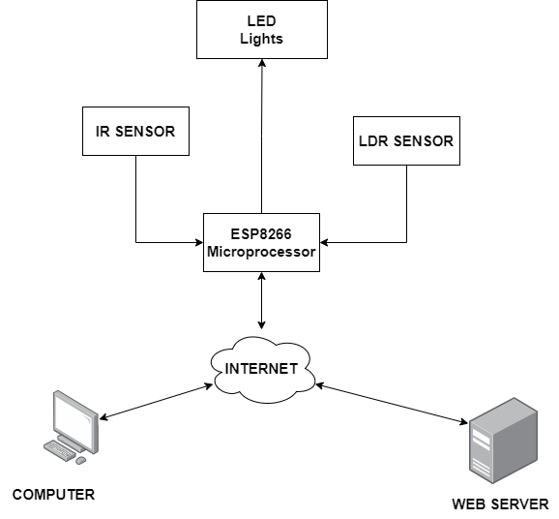
PROPOSED SYSTEM

Slide 15
IMPLEMENTATION
ThingSpeak is a cloud based data platform which is used to send and receive the data in real time using HTTP protocol.
A mobile based application provided by Thingspeak is used to control and detect the faults in the lighting system.
The system uses HTTP protocol to exchange data between terminal device (Arduino Module) and head device(Server + Website) with intermediate device
IR sensors are installed at each street light.
LDR sensor is used to detect the intensity of the light present and turn them ON/OFF accordingly.

Slide 16
CONCLUSION
This project could be a price effective, eco-friendly and therefore the safest technique to save energy and through this method the light status data is accessed from anytime and anywhere. It clearly tackles the matter and the planet is facing these days that’s, saving energy. The project has scope in varies alternative applications like for providing lighting in industries, campuses and parking lots of large spaces like malls.

Slide 17
REFERENCES
[1] Elejoste P, Angulo I, Perallos A, Chertudi A, Zuazola IJ, Moreno A, Azpilicueta L, Astrain JJ, Falcone F, Villadangos J. An easy to deploy street light control system based on wireless communication and LED technology. Sensors. 2013 May 16;13(5):6492-523.
[2] Sung, Wen-Tsai, and Jia-Syun Lin. "Design and implementation of a smart LED lighting system using a self adaptive weighted data fusion algorithm." Sensors 2013, Dec 6;13(12):16915-39.
[3] Escolar, S., Carretero, J., Marinescu, M.C. and Chessa, S., Estimating energy savings in smart street lighting by using an adaptive control system. International Journal of Distributed Sensor Networks. 2014
[4] Mohamed SA. Smart street lighting control and monitoring system for electrical power saving by using VANET. Int'l J. of Communications, Network and System Sciences. 2013 Jul 26;6(08):351.

Slide 18
REFERENCES
[5] Müllner R, Riener A. An energy efficient pedestrian aware Smart Street Lighting system. International Journal of Pervasive Computing and Communications. 2011 Jun 28;7(2):147-161.
[6] Pizzuti S, Annunziato M, Moretti F. Smart street lighting management. Energy Efficiency. 2013 Aug 1;6(3):607-616.
[7] Rajput KY, Khatav G, Pujari M, Yadav P. Intelligent street lighting system using gsm. International Journal of Engineering Science Invention. 2013 Mar;2(3):60-9.
[8] Yusoff YM, Rosli R, Karnaluddin MU, Samad M. Towards smart street lighting system in Malaysia. InWireless Technology and Applications (ISWTA), 2013 IEEE Symposium on 2013 Sep 22 (pp. 301-305). IEEE.

Slide 19
THANK YOU

